Slide 1
Moving Beyond Manual Counting How Automated License Plate Recognition-Based Occupancy Studies can Help Cities Evaluate Parking Policy
T2 Connect Conference
Brett Wood, Kimley-Horn
November 17, 2015

Slide 2
Agenda
Traditional LPR use
Traditional data collection processes
LPR as a Data Collection Tool
The Kimley-Horn Pilot Test
Challenges
The “Ah Ha” Moment
Practical Applications
Enhancing the process
Improving the Technology for Everyone

Slide 3
Traditional Approaches and Tools

Slide 4
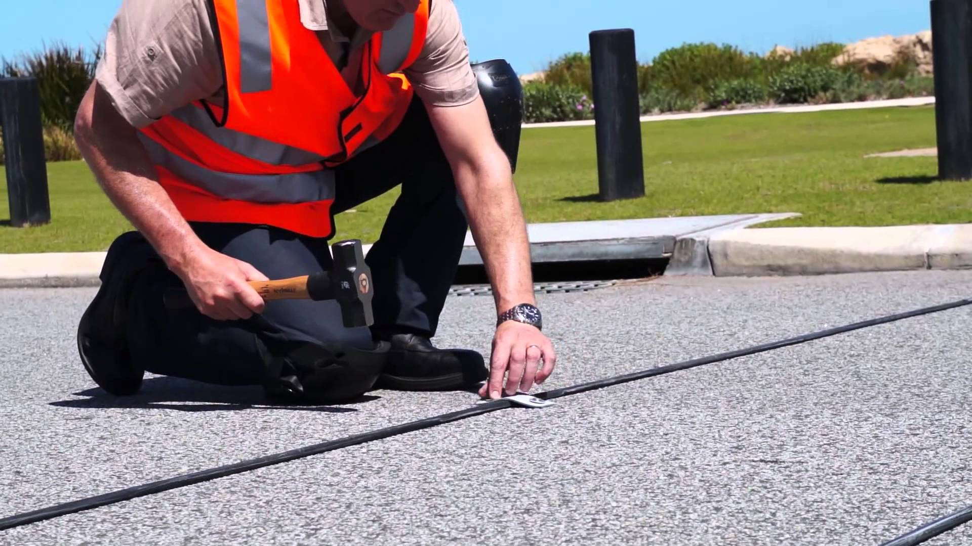
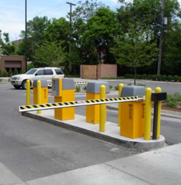
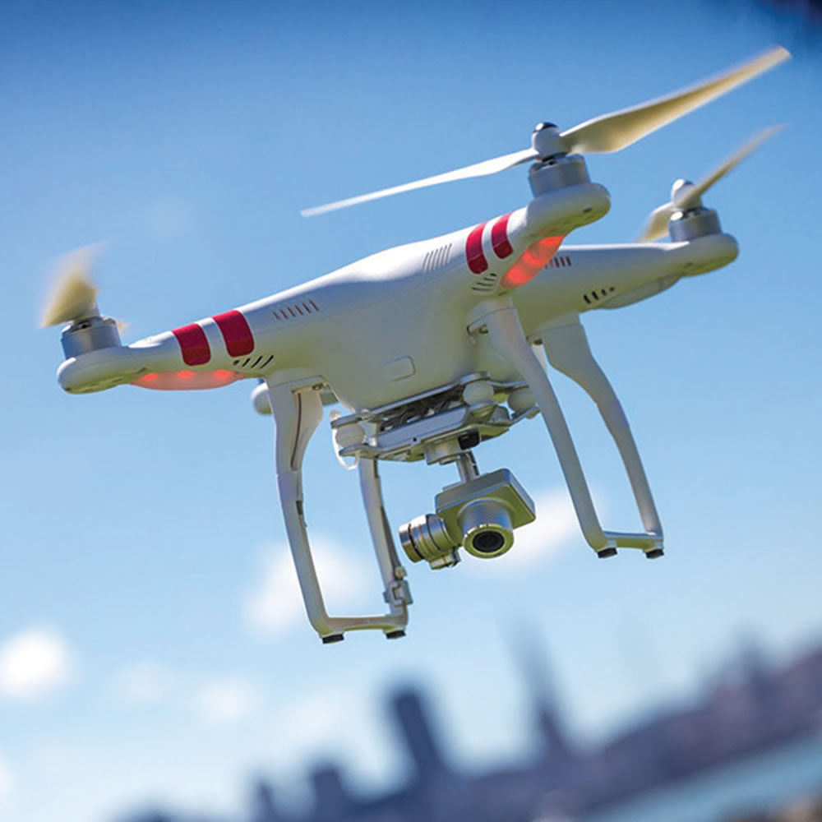
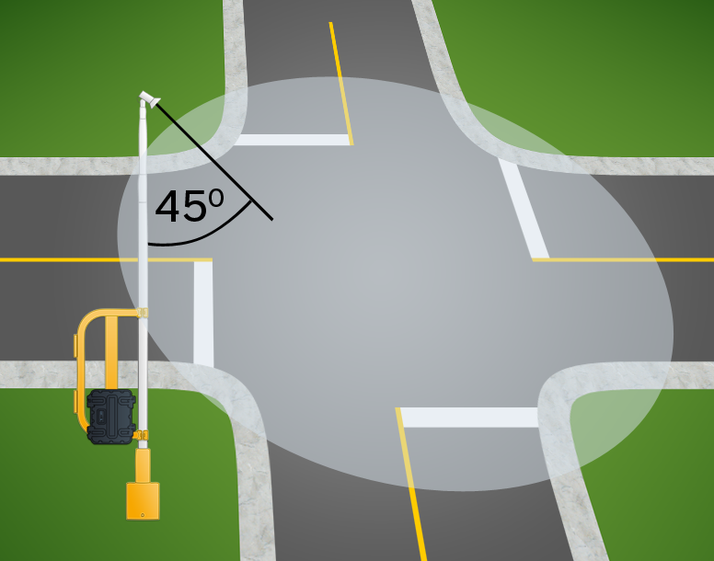
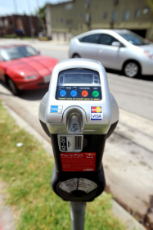
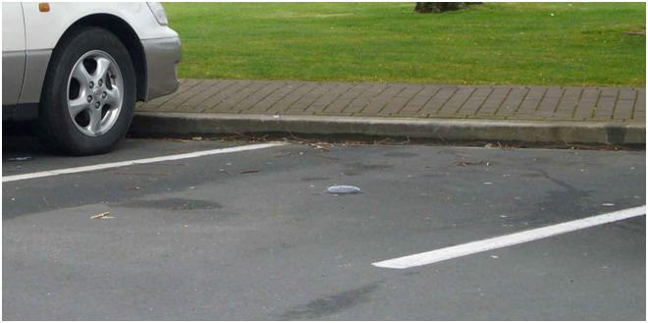
Traditional Approaches to Data Collection
Manual data collection
Video data collection
Counters and sensors
Revenue control equipment
Advanced approaches

Slide 5
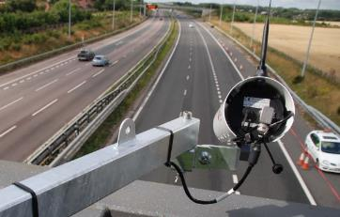
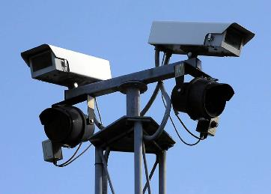
Traditional LPR use: Fixed
Invented in the 70’s, big adoption in the 90’s

Slide 6
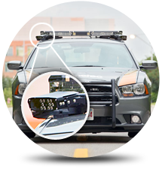
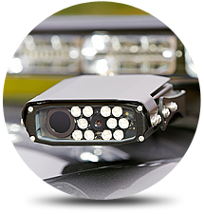
Traditional LPR use: Mobile Law

Slide 7
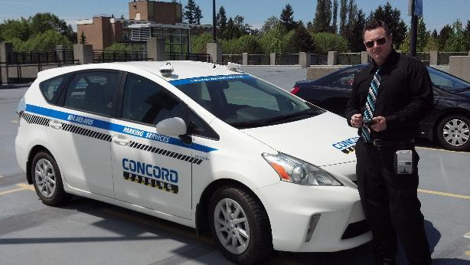
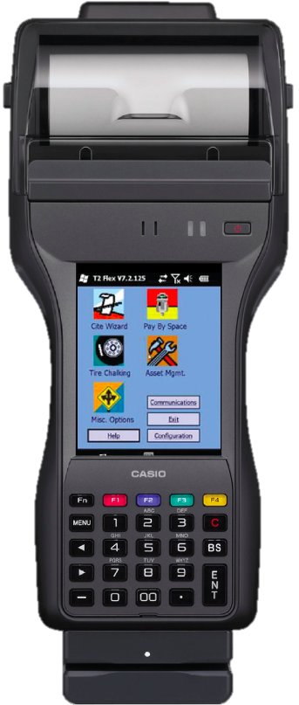
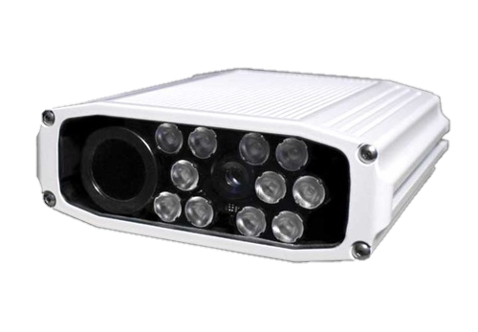
Traditional LPR use: Parking

Slide 8
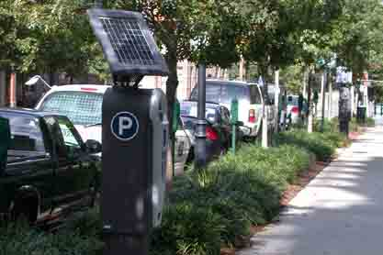
Next Step … Occupancy

Slide 9
How well does LPR work?
Exception may include: Plates that do not have a reflective coating or that lost their reflective coating. Plates with physical damages (cracked, bent, dented, stretched …) that distort characters or spaces. Plates that are damaged such that they do not retain an overall rectangular shape. Plates that may be physically obscured from the LPR camera. Plates with non-standard fonts or non-standard spacing. Plates with fixtures that distort characters or spaces. Plates that have been captured more than once. Plates with fixtures that touch characters. Plates that are extremely dirty. Specialty interest plates. False positive plates that are triggered by an environmental item other than a vehicle plate, such as a fence or bumper sticker, are considered to be illegitimate plates
“Our system will read 99% of plates.” *
*

Slide 10
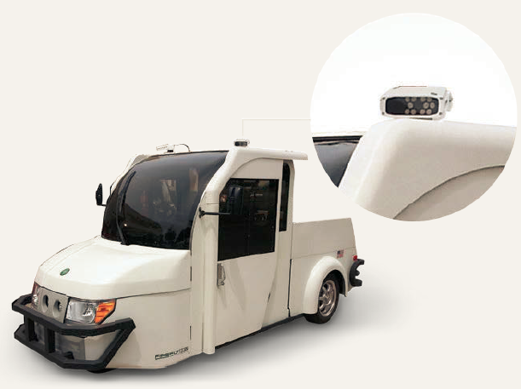
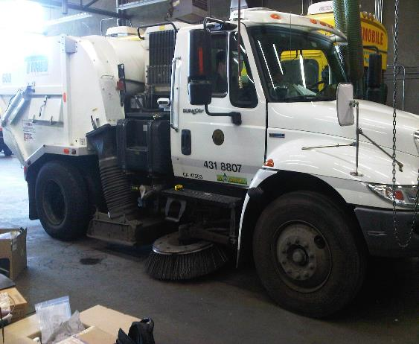
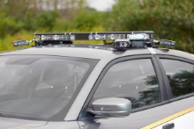
Challenges with LPR as a data collection tool
Properly installed and calibrated system.
Parking vs Law vs Street Sweeper

Slide 11
Single Plate Vehicles backed in

Slide 12
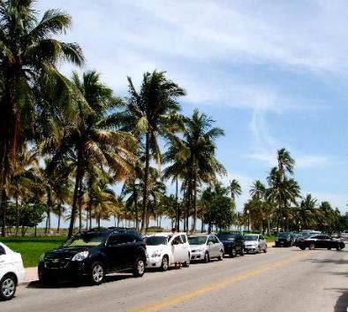
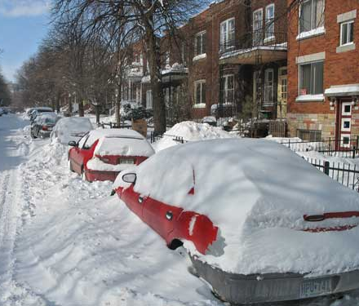
What about climate ?
Notes:
Desired enforcement type
45, 90, parallel
One or both sides, simultaneous
Day night
Climate

Slide 13
Variety of plates to be read
French plate
Spanish plate
Greek plate
Italian plate

Slide 14
Variety of plates to be read
Oregon plate(s)
+ 10

Slide 15
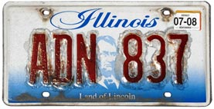
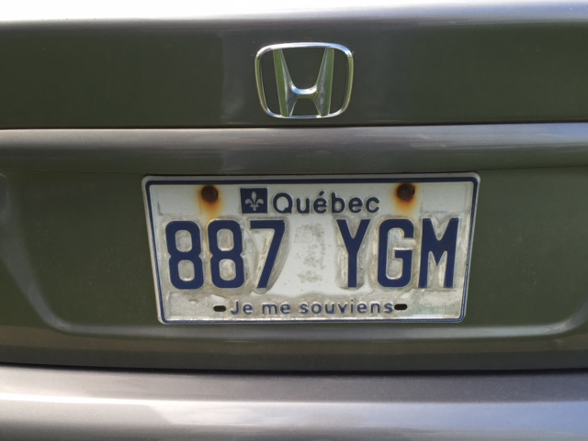
Damaged Plates

Slide 16
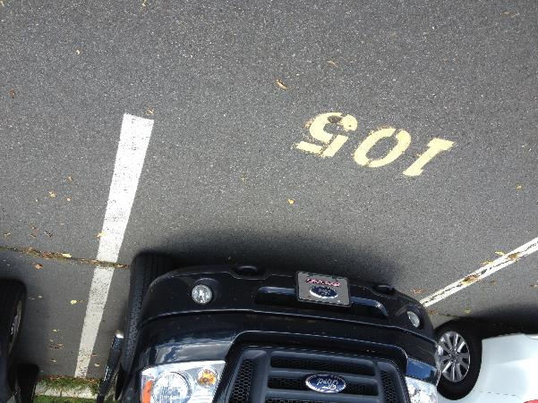
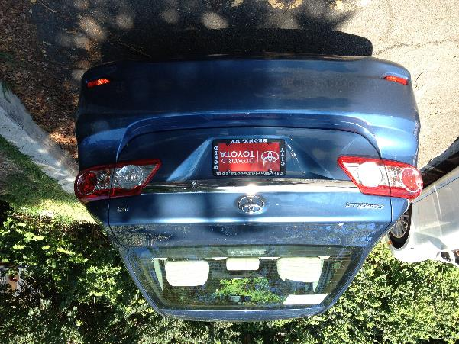
Plates we will always miss

Slide 17
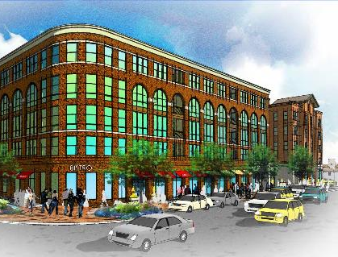
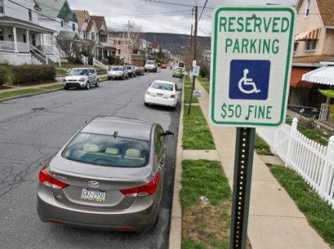
What about Location?
GPS (Global Positioning System) can vary from 3 to 30 ft.
Enhanced options can increase this significantly, in some cases to < 1”!

Slide 18
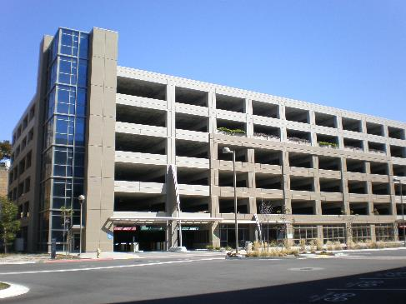
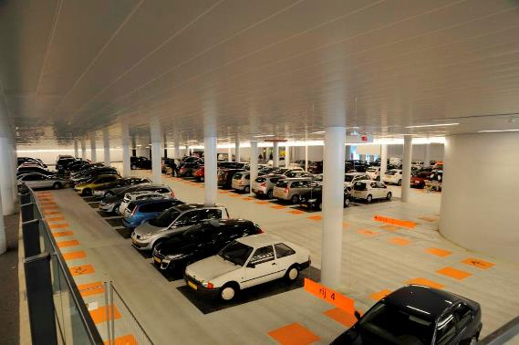
GPS is not always an option

Slide 19
The Kimley-Horn Pilot Study

Slide 20
LPR as a Data Collection Tool
What Makes LPR an Effective Option?
Mobile mounted
Gathers data related to vehicle presence
Stores data geospatially and quantitatively
Opportunities for occupancy and duration

Slide 21
The Kimley-Horn Pilot Study
6 month pilot study, conducted in:
Tempe, AZ; Phoenix, AZ; Fort Collins, CO; Houston, TX; Beverly Hills, CA
Purpose of the pilot study was to determine:
Challenges
Opportunities
Accuracy
Efficiency
Staff power requirements

Slide 22
General Parameters of the Pilot Test
Early Phases:
Conducted in Arizona at KH office and Tempe parking system
Define protocols for data collection processes
Test the accuracy of the system
Determine efficiency and limitations

Slide 23
The Data Collection Process

Slide 24
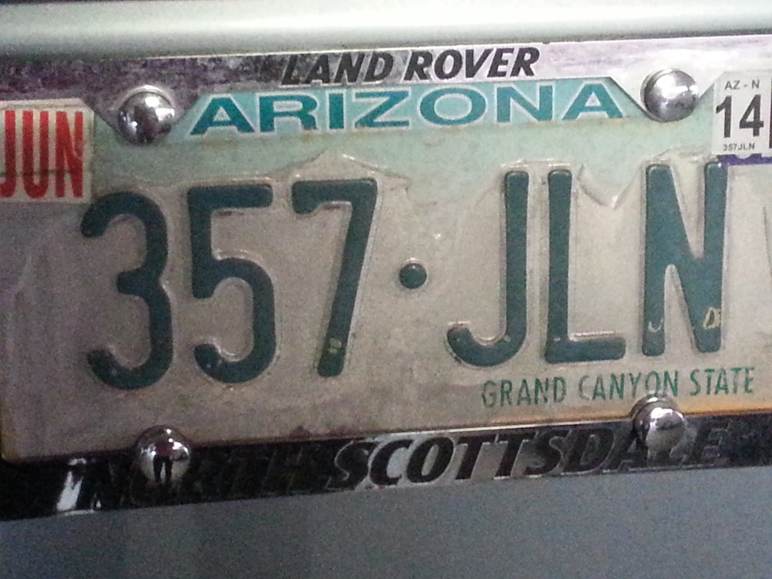
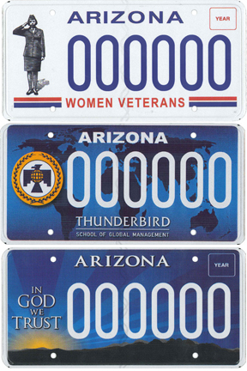
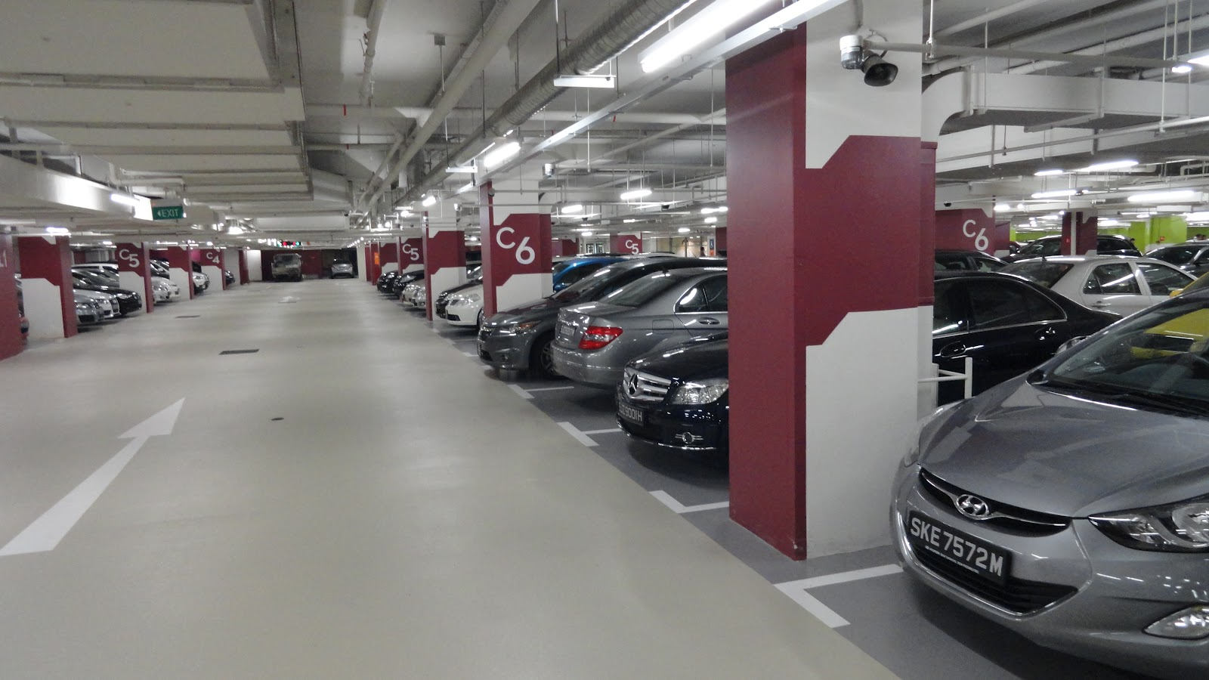
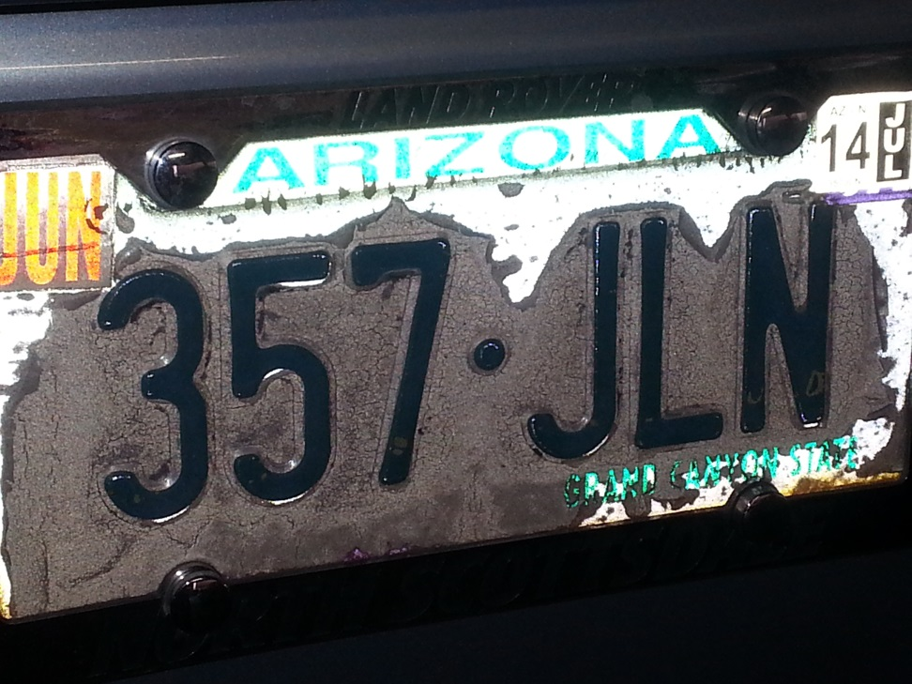
Early Challenges
Front and back license plates (or lack thereof…)
Custom license plates
Melted license plates

Slide 25
General Parameters of the Pilot Test
Mid Phases:
Conducted in Tempe and Colorado State University parking systems
Improve performance by overcoming challenges
Add manual counting for backed-in cars with no license plates
Work with vendor to code new license plates
Determine efficiency of “traveling calibration”

Slide 26
The “AH HA” Moment
Facility | Manual Count | LPR | Accuracy
City Hall Garage | 245 | 160 | 65%
Brickyard Garage | 170 | 138 | 81%
Surface Lots | 78 | 61 | 78%
Centerpoint Garage | 733 | 468 | 64%
Average |  |  | 72%
Facility | Manual Count | LPR | Accuracy
City Hall Garage | 239 | 229 | 96%
Brickyard Garage | 674 | 611 | 91%
Surface Lots | 173 | 160 | 92%
Centerpoint Garage | 254 | 258 | 102%
Average |  |  | 95%
The addition of manual counting of backed-in vehicles nailed the accuracy of the system
When traveling to locations with front and back license plates, accuracy was stellar
Notes:
Arizona does not require a front license plate
Test 1 – LPR do all the work
Test 2 – we included backed in vehicles with the counts
Also tested in Houston, Fort Collins, and Beverely Hills – which require front and back license plates, and we were getting similar accuracy percentages
Also, notice 102%, LPR may collect a random sign that you’ll pass or a logo on a car, but, after a full day of data, these anomalies will normalize

Slide 27
Mid-Pilot Challenges
How do we actually use this data?
Reports from back-end system were configured for enforcement
No easy way to define parking occupancy from reports
Geospatial tool was helpful for on-street and surface lots

Slide 28
General Parameters of the Pilot Test
Final Phases:
Conducted in Tempe, Houston, Beverly Hills
Develop reporting and analysis mechanism
Use existing parameters within back-end reporting to “trick” reports to provide occupancy
Automate reporting
Test staffing theory’s with non-KH staff
Parking management staff in Houston
Parking enforcement staff in Beverly Hills

Slide 29
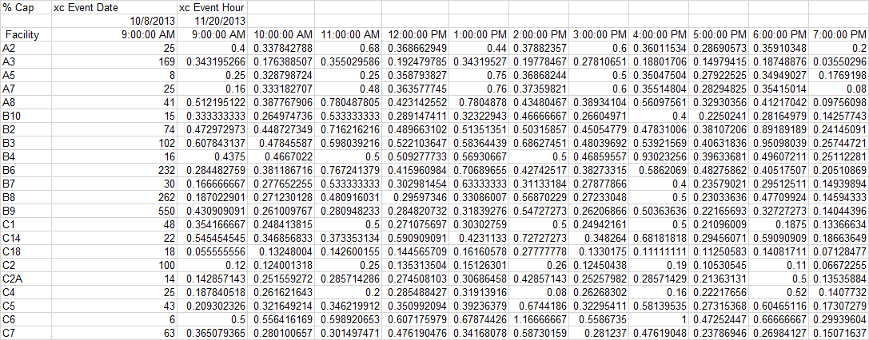
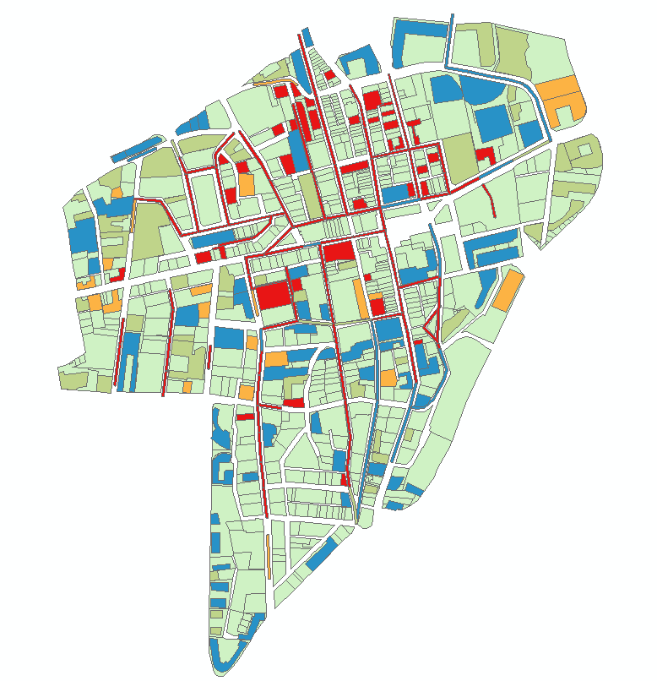
Effective Reporting Tools

Slide 30
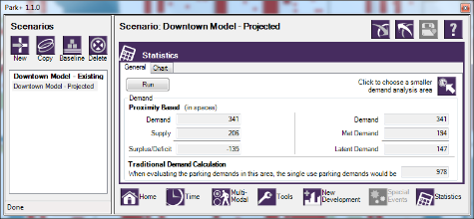
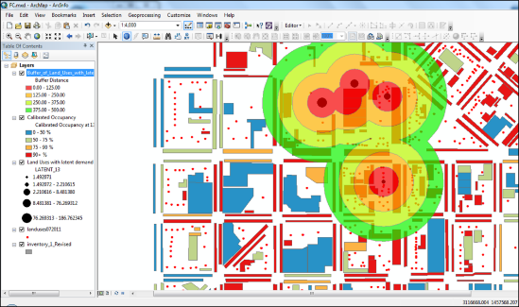
How do WE use the data?
Park+ Modeling
Scenario Planning Tool
Use for Data:
Calibrating models for communities
Evaluating event scenarios
Defining new demand projections
Maintaining and updating models

Slide 31
Final Pilot Results
Each test presented a unique challenge… with an equally unique solution
Staff power estimates showed a reduction of up to 50% for most efforts
Meaning more data can be collected in the same time and budget as previous efforts
Data accuracy was within acceptable levels for our purposes
We are the proud owners of an LPR unit that finds itself all over the country…

Slide 32
Practical Applications

Slide 33
Asheville, NC
~15,000 parking spaces
Collection of on-street and off-street occupancy
Comparison of demand collections from 2007, 2010, and 2014
Notes:
One analyst, two days for collection process
One day for post processing

Slide 34
Atlanta, GA
Update of previous occupancy study from 2008
Collected parking data at 30+ parking facilities over a 3 day span
Determine average and overall peaks
Notes:
Two analysts, three days for collection process
One day for post processing

Slide 35
Miami, FL
Hourly on-street occupancy data collection in support of performance-based pricing evaluations
Data collected allowed the project team to determine user characteristics and derive policy recommendations

Slide 36
Denver, CO
Evaluate parking behavioral characteristics in Prospect Park neighborhood
Occupancy, duration, movement, and appropriate usage

Slide 37
Using Geospatial Analysis to Improve Studies

Slide 38
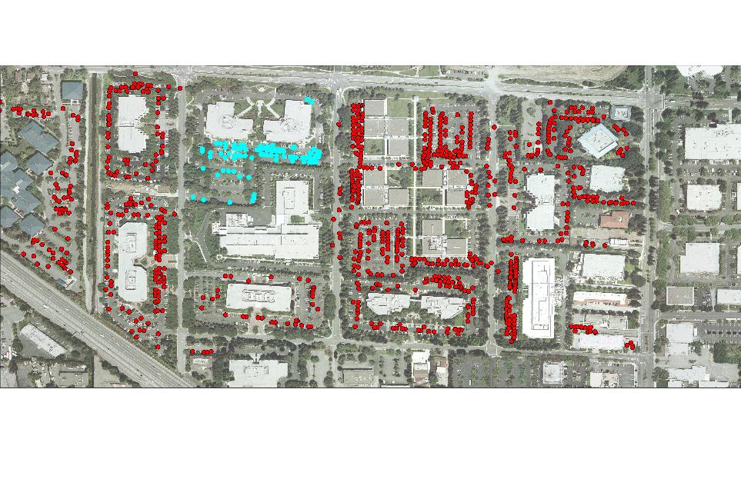
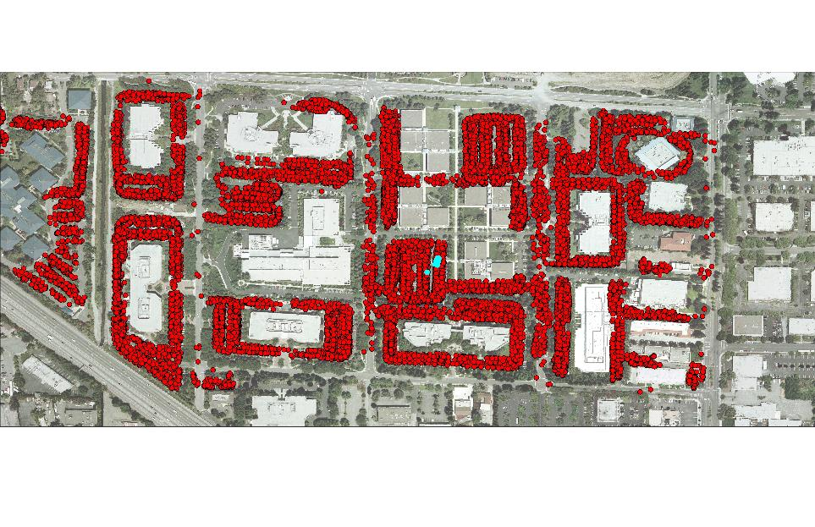
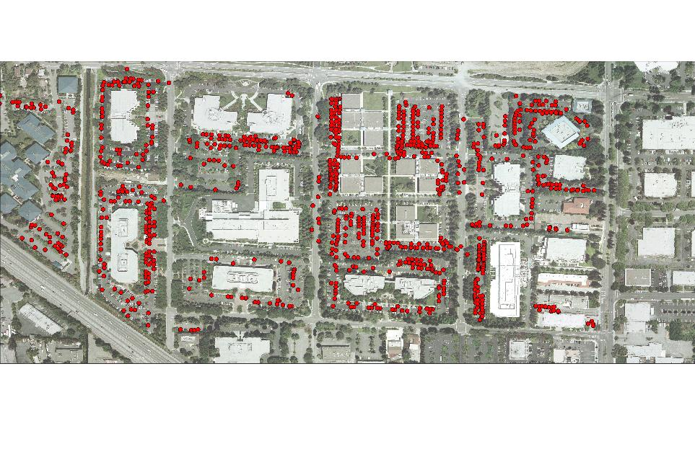
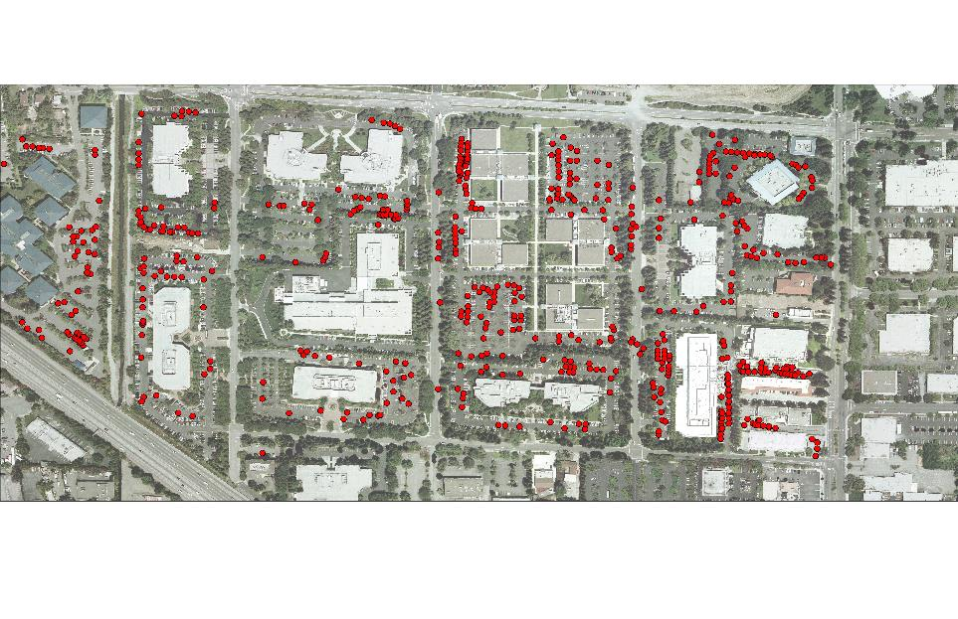
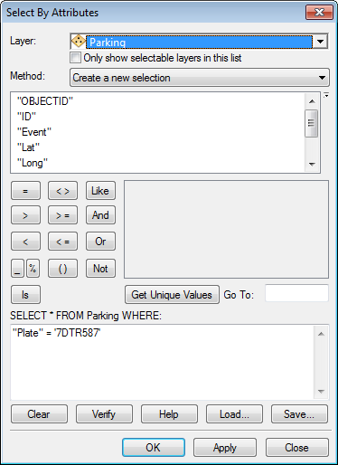
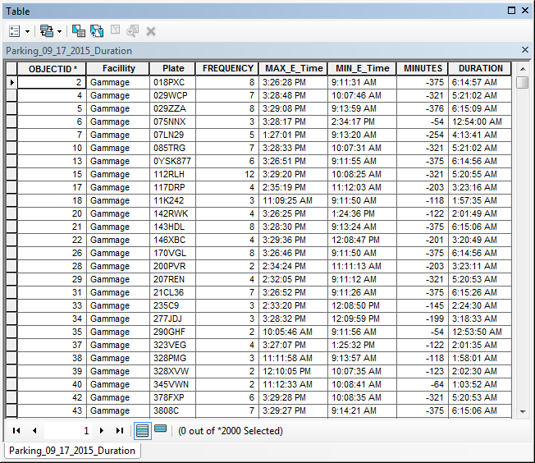
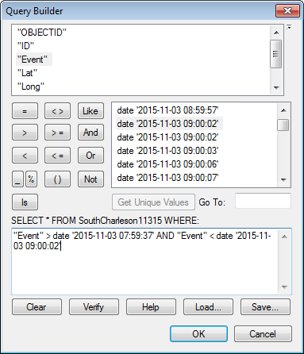
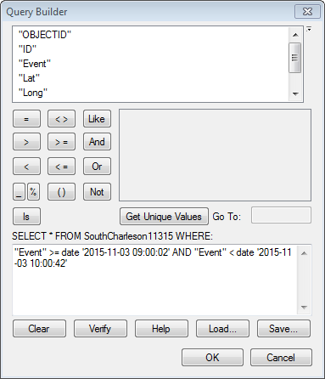
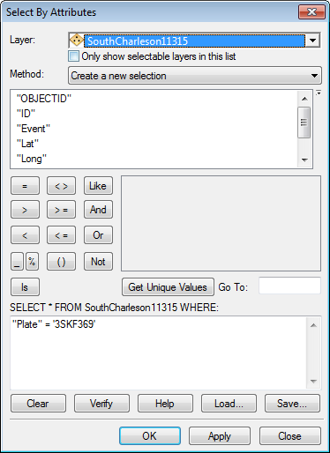
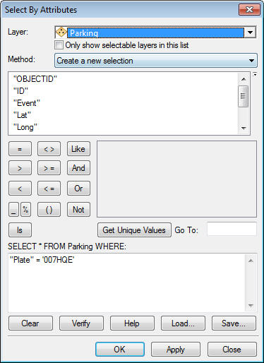
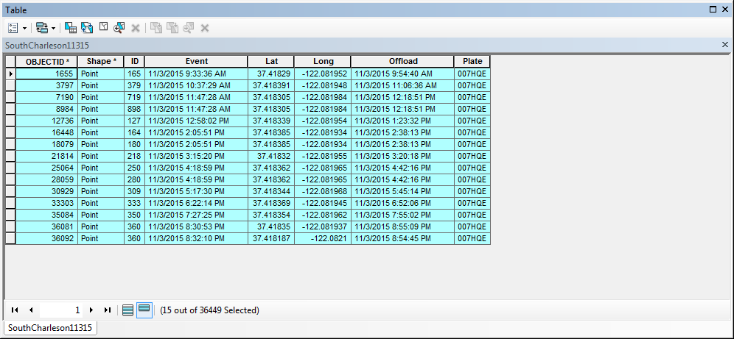
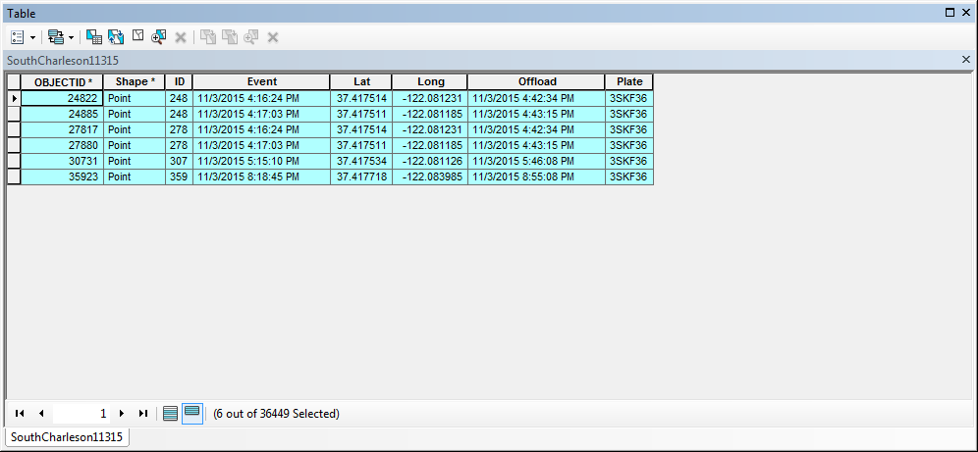
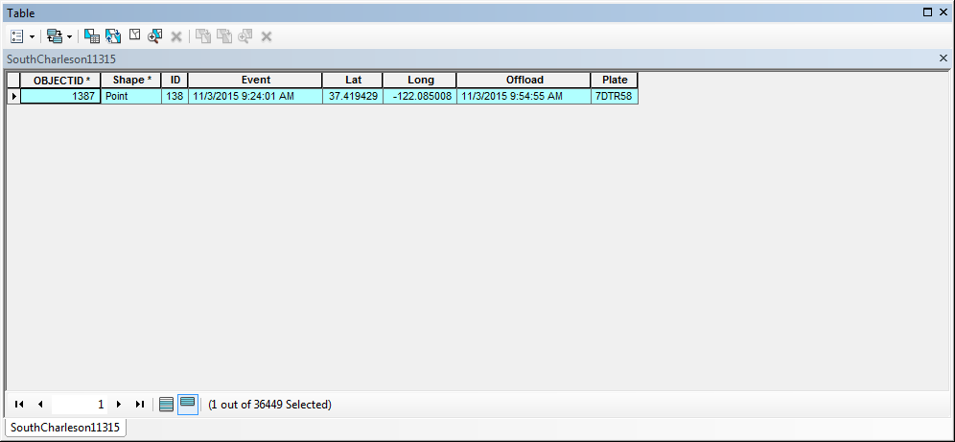
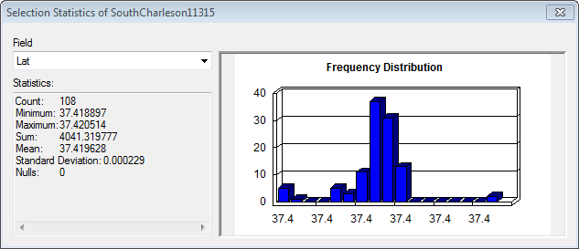
Enhancing the Process

Slide 39
Improving the Technology for Everyone

Slide 40
How Can Everyone Use LPR for Data Collection
Work with your vendor to configure specific reports
Identify critical data points and work to define how to report for useful analysis
Determine routing and process as part of regular collection efforts
Identify key data points to use as benchmarks for program evaluation
Use data to manage and evolve program

Slide 41
Questions?
Brett Wood, P.E., CAPP
brett.wood@kimley-horn.com
919-412-0145

